Slide 1



Wavecon Dashboard Analysis
Codebasics Virtual Intenship Challenge

Slide 2
Introduction
Wavecon is one of the leading telecom providers in India and launched it’s 5G plans in May 2022 along with other telecom providers
However, the management noticed a decline in their active users and revenue growth post 5G launch in May 2022.

Slide 3
Details of Data
January
February
March
April
June
July
August
September
}
Befor 5G
May - 5G implementation - No data
}
After 5G

Slide 4
Main KPIs
ARPU – Average Revenue Per User
Revenue – Revenue for all the plans
Active users – Number of Persons who are using the network
Unsubscribed users – Number of Persons who left the network

Slide 5
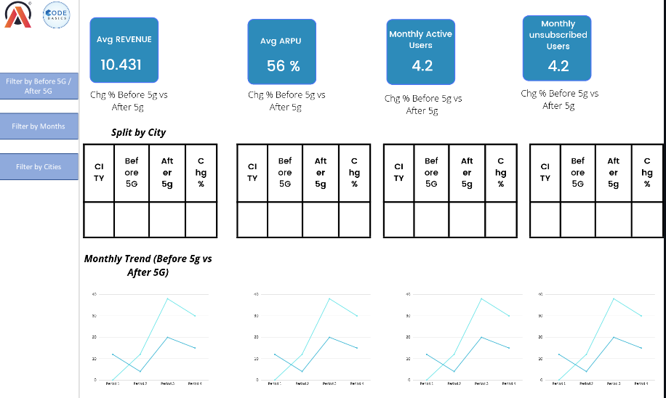
Mock-Up Dashboard-1

Slide 6
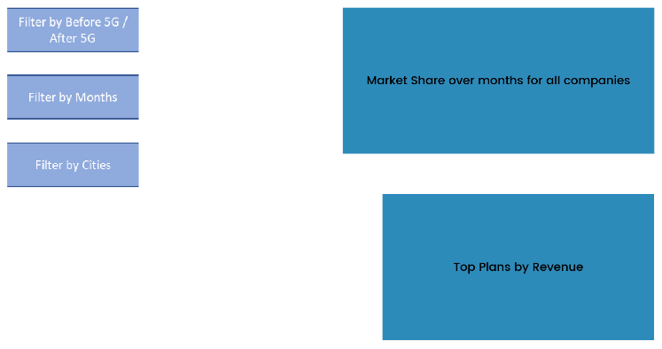
Mock-Up Dashboard-2

Slide 7
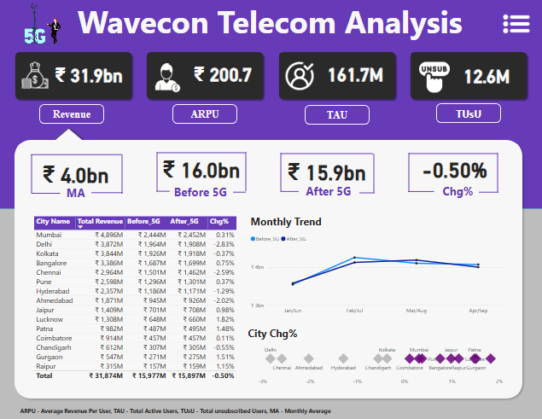
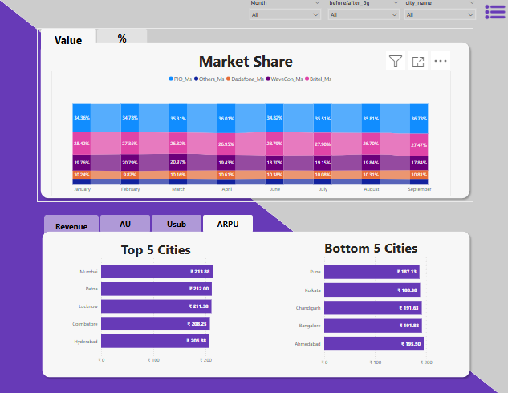
My Design-1

Slide 8
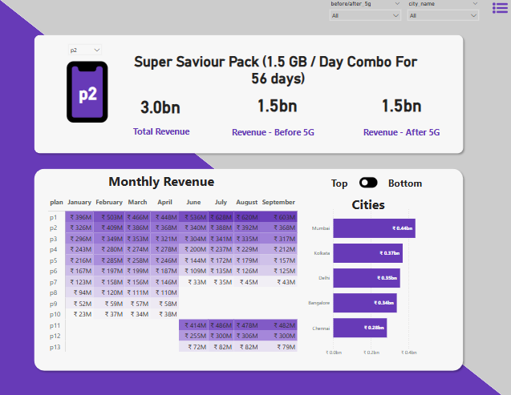
My Design-2

Slide 9


Slide 10
Thank
You

